Slide 1
The ‘Well mi’ study Wellbeing, health and fitness of children with mobility impairments (Well mi)
Can you help by telling us what you think about keeping fit?

Slide 2
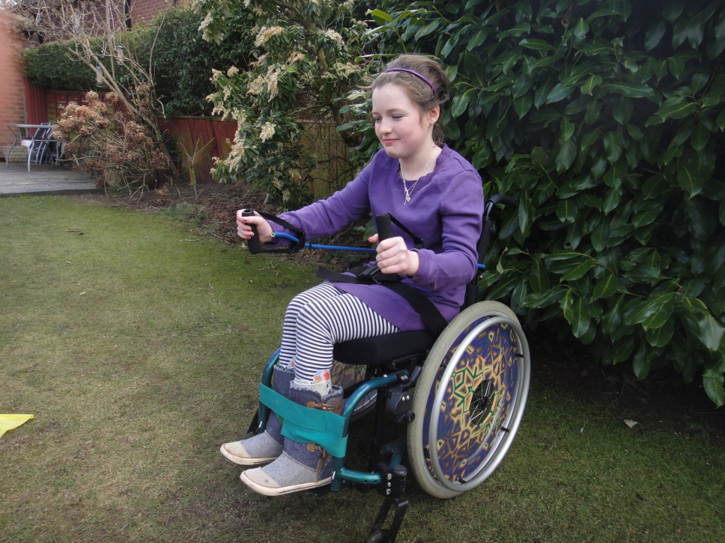
If you use a wheelchair most or all of the time, you can help us.

Slide 3
What is the study about?
The Well mi study is about designing fun keep fit activities for children and young people who use wheelchairs.

Slide 4
Stage 1 of the Well mi study
In the first part of the study, we want to ask you questions such as:
What you think about fun keep fit activities?
What fun things would you like to do more of to keep fit?
We will record what you say with a voice recorder.

Slide 5
Where will I have to go to take part?
The researcher can come to your home to talk to you and your parents
or
The researcher can talk to you and other children at a place near where you live (such as a leisure centre)

Slide 6
Stage 2 of the Well mi study
During stage 2 of the research we will ask you to tell us about how you feel, and measure your physical health.
We want to know about:
Your breathing
Your heart rate
the energy your body uses
Your general level of fitness

Slide 7
How will you measure my breathing?

Slide 8
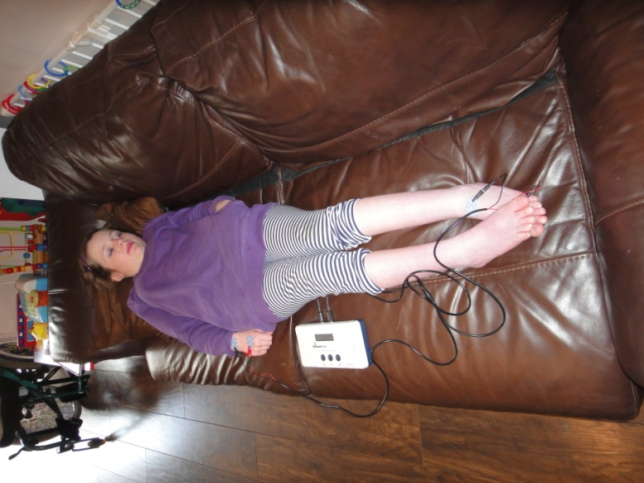
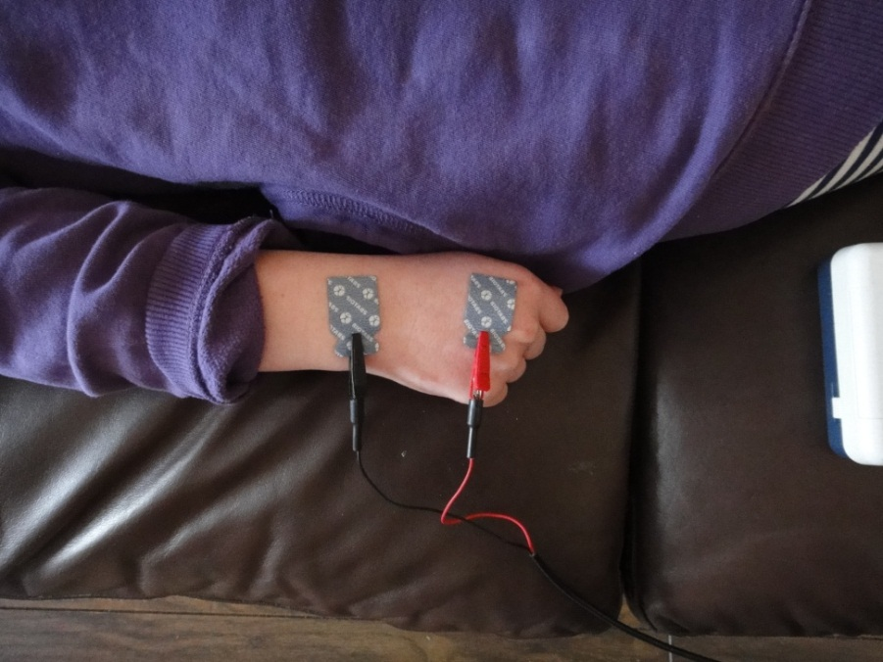
How will you measure my body?
We will place electrodes on your right hand and left foot to measure your body fat.

Slide 9
How will you test my general level of fitness?

Slide 10
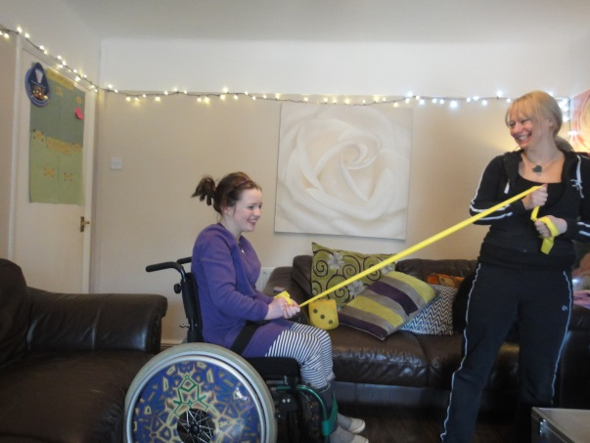
Stage 3 of the Well mi study
What do you think of the fun keep fit activity tool kit?
How we can make the fun activity tool kit better?
We will also ask your:
Parents
Therapists
Carers
We will test out the tool kit in another study in the future.

Slide 11
Are you between 6 and 18 years old?

Slide 12
Would you like to take part in the Well mi study?
If you are interested, you can help us with any or all of the
3 stages of the Well mi study.

Slide 13
Do I get anything for taking part?
To say thank you for your help. We will give you either High Street vouchers or itunes© vouchers.
You will get vouchers worth £15 each time you take part in the Well mi study.

Slide 14
Contact details
Please get in touch.
We would really appreciate your help with the study.
Address:
Dr Llinos Spencer
Well mi study Research Officer
Centre for Health-Related Research
Fron Heulog, Ffriddoedd Road
FREEPOST BG35
Bangor, Gwynedd, LL57 2BR
Telephone: 01248 38 3171
Email: L.spencer@bangor.ac.uk
Website: http://wellmi.bangor.ac.uk

